Slide 1
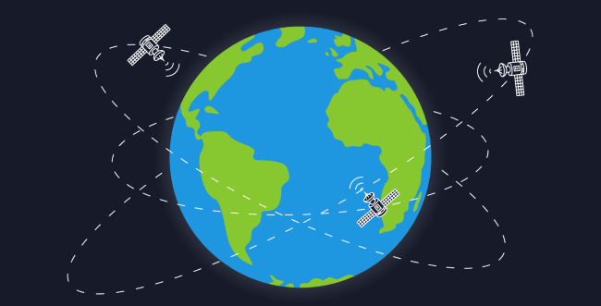
Advanced Seminar Topic
Global Positioning System and Differential GPS
by
Preetham Ganesh Kamisetty
15641A0496
-Vaagdevi College of Engineering-

Slide 2
1.What is GPS
2.Evolution of GPS
3.GPS Structure
4.GPS Determining Position
5.TRILATERATION
6. ADVANTAGES AND DISADVANTAGES
7.APPLICATIONS
8.DGPS
9.Pseudo Range Errors
10.Correcting Signal Delays
11.Conclusion
TABLE OF
CONTENTS

Slide 3

What is GPS ?
Global Positioning System
Satellite-based Navigation System
Roger L. Easton- Ivan A. Getting-Bradford Parkinson
*Years to Remember* 1973 and 1995

Slide 4
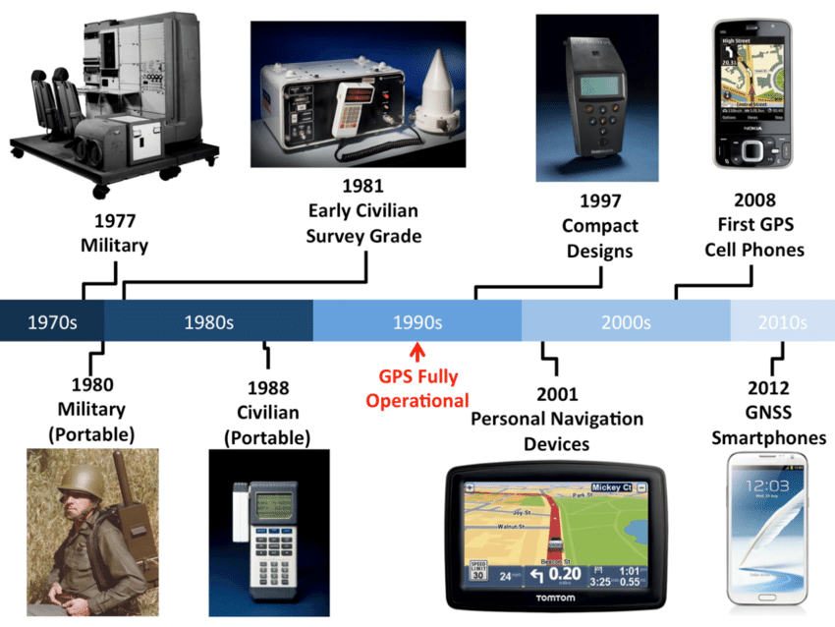
Evolution of GPS

Slide 5
GPS
Space Segment
Control Segment
USER Segment
How does GPS System Work?
Uplink Data
Downlink Data

Slide 6
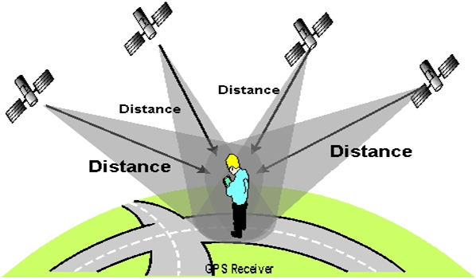
How GPS Determines a Position:
GPS pinpoints the User Location using a method called
Trilateration

Slide 7
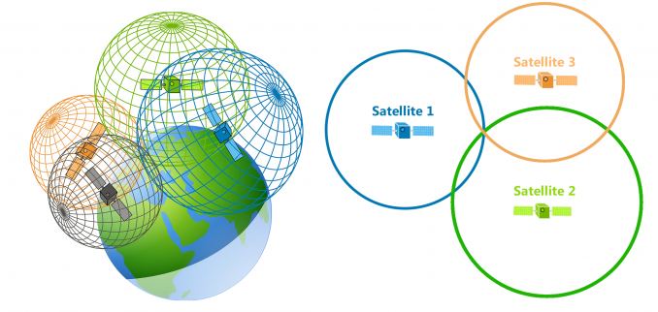
GPS Receivers Use Trilateration

Slide 8

ADVANTAGES AND DIS-ADVANTAGES
ADVANTAGES
GPS important tool for military, civil
and commercial users.
Vehicle tracking systems
Very high speed
Dis-Advantages
GPS satellite signals are too weak
when compared to phone signals.
The highest accuracy requires line-of-sight.

Slide 9

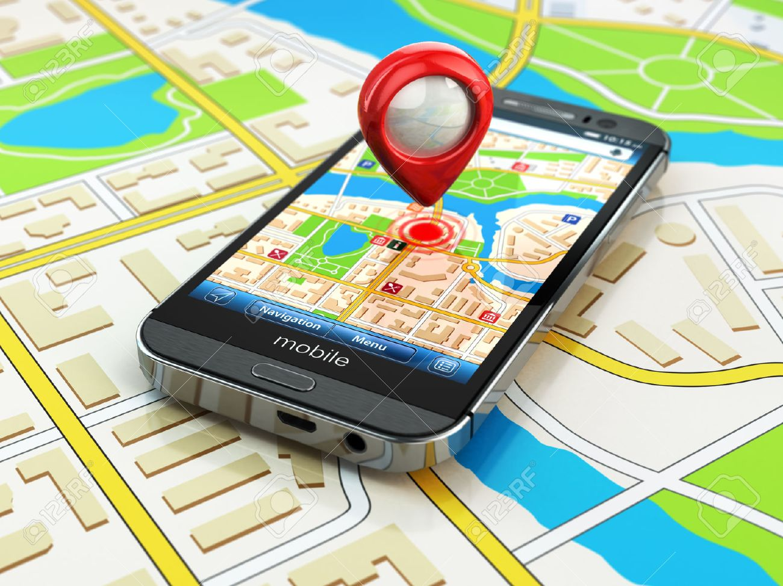
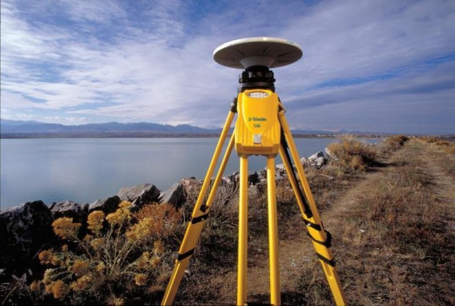
Applications
Military
Telecommunications
Surveying
Military use GPS as a Defense Mechanism during War times.
Can be able to locate Vehicles and Missiles during war.
Implemented in Mobiles to help in navigating Routes during travelling.
Can also synchronize time zones using GPS signals.
Used in mapping and measuring various measures on the earth surface and underwaters.
Used to Determine Boundaries of Land and Seafloors.

Slide 10
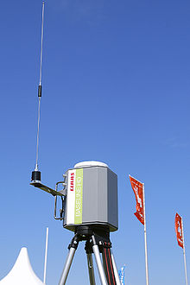
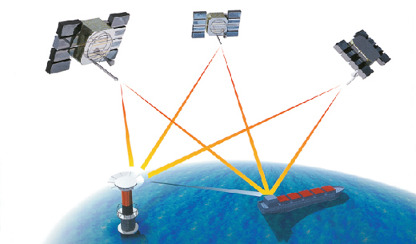
What is DGPS ?
Differential GPS
Positional corrections to GPS signals
Eliminates Pseudo range Errors

Slide 11
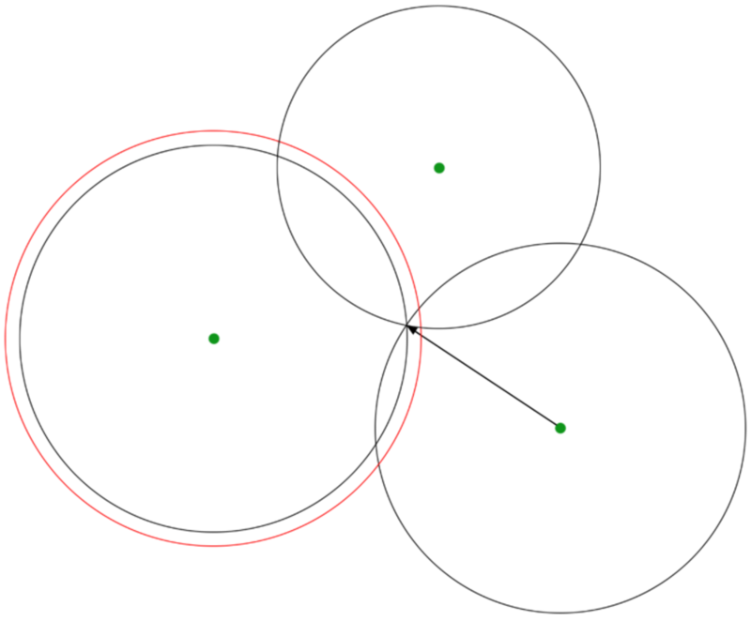
What are Pseudo range errors?
GPS signals coming from satellites down to the ground have to travel through layers of the earth’s atmosphere, so they are subjected to delays. This affects the time taken for the signal to travel from any given satellite to a GPS receiver, which introduces slight error into the GPS engine, causing an error in the measured position.
what actually causes these signal delays?
Ionosphere
Troposphere

Slide 12
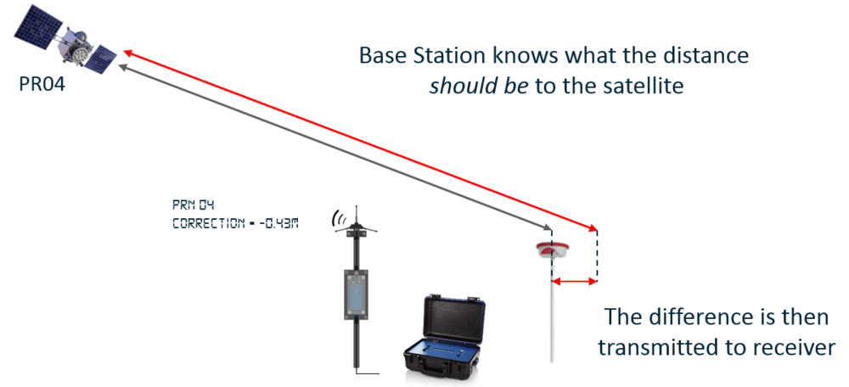
Correcting Signal Delays
#1 Static Base Stations

Slide 13
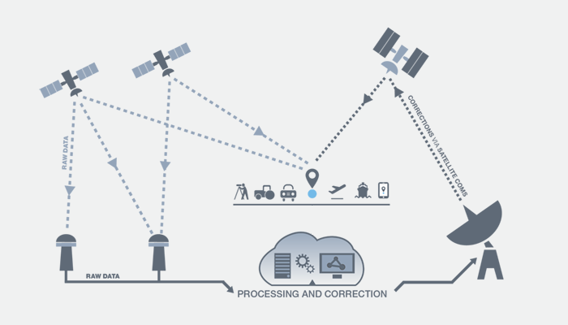
#2 Geostationary Satellites
SBAS (Space Based Augmentation System)

Slide 14
CONCLUSION
As of February 2017, there are 31 operational GPS satellites in the orbit.
Currently, the US is working on the GPS III.
The new constellation of satellites will enhance signal reliability and accuracy and have a 15-year design lifespan.
After the deployment of new satellites, the accuracy, uptime and accessibility of GPS will improve all around the world.
The future of GPS tracking is going to be more accurate and effective for Personal Tracking, as well as business use.

Slide 15

by
Preetham Ganesh Kamisetty
15641A0796

